Slide 1

CREDIT RISK ANALYSIS REPORT
1. Overview
2. Analysis result
3. Summary

Slide 2
OVERVIEW
Lending companies face to risky that borrowers will not toward the loans.
There are many ways to measure the qualifications of lenders.
In this analysis, Machine Learning is applied to analyze a dataset of historical lending activity from a peer-to-peer lending services company to build a model that can identify the creditworthiness of borrowers.
According to the loan status provided by the lending company, the machine learning model will determine which loans are healthy (low-risk) or non-healthy (high-risk)
The Logistic Regression Algorithm is one of the best tools to use for machine learning models as it is widely used to predict the probability of a target variable in classification problems.
Based on the dataset provided by the lending company, Logistic Regression Model generated an accuracy score of 95%. Although the model generated a high accuracy, the model's recall value (0.91) for non-healthy loans is lower than the recall value (0.99) for healthy loans. This indicates that the model will predict the status of loans as healthy better than being able to predict loan statuses as non-healthy

Slide 3
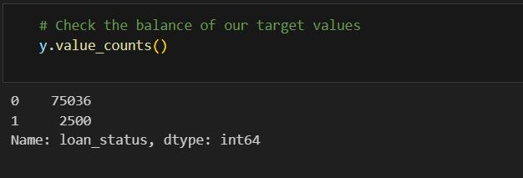
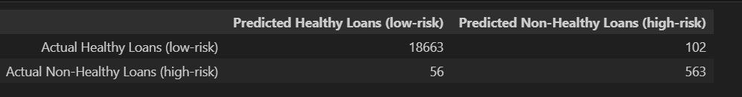
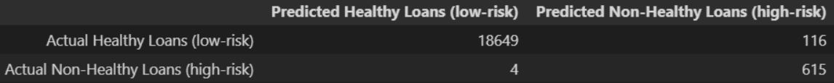
ANALYSIS RESULT
Generate a confusion matrix
- Out of the 18,765 loans that are healthy (low-risk), the model predicted 18,663 as healthy correctly and 102 as healthy incorrectly.
- Out of the 619 loan statuses that are non-healthy (high-risk), the model predicted 563 as non-healthy correctly and 56 as non-healthy incorrectly
When we "Split the Data into Training and Testing Sets", the value_counts() function shows the data is highly imbalanced. The majority class is healthy loans [0] and the minority class is non-healthy loans
To generate a higher accuracy score and have the model catch more mistakes when classifying non-healthy loans, we might oversample the data using the RandomOverSampler module from the imbalanced-learn library, which adds more copies of the minority class (non-healthy loans) to obtain a balanced dataset.
Based on dataset provided by the lending company, Logistic Regression Model was created to fit with the oversampled data that generated an accuracy score of 99%, which turns out to be higher than the model fitted with imbalanced data. The oversampled model performs better due to the dataset being balanced. The model non-healthy loans recall value increased from 0.91 to 0.99 indicating that the model does an exceptional job in catching mistakes such as labeling non-healthy (high-risk) loans as healthy (low-risk).
According to the confusion matrix
Out of the 18,765 loan status's that are healthy, the model predicted 18,649 as healthy correctly and 116 as healthy incorrectly.
Out of the 619 loan status's that are non-healthy (high-risk), the model predicted 615 as non-healthy correctly and 4 as non-healthy incorrectly

Slide 4
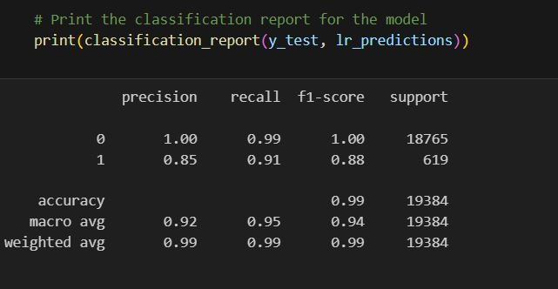
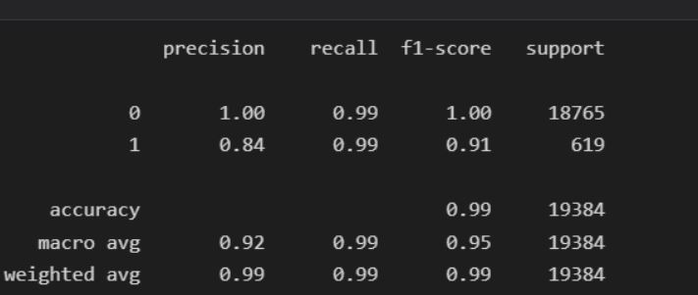
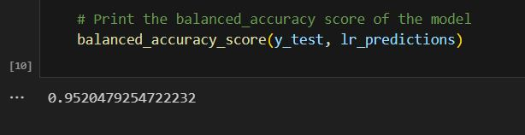
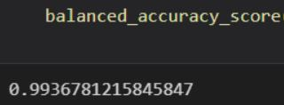
ANALYSIS RESULT
-The Logistic Regression model provided the Imbalanced Data Set predicted healthy loans 100% of the time and predicted non-healthy loans 85% of the time.
The model fitted with imbalanced data has a higher possibility of making these mistakes:
-Healthy loan (low-risk) is classified as a non-healthy loan (high-risk).
a non-healthy loan (high-risk) is classified as a healthy loan (low-risk).
-Based on the model recall scores, the model made 1% of mistakes when predicting healthy loans and made 9% of mistakes when predicting non-healthy loans

Slide 5
SUMMARY
The Logistic Regression model fitted with OverSampled data works much better than the model fitted with Imbalanced data due to the data being balanced and generating a higher accuracy score and a higher recall, indicating that the model will make extremely fewer mistakes when classifying non-healthy loans. The lending company might want fewer False Positives because the high possibility of a lender losing provided funds when classifying non-healthy loans as healthy. The data below is shown in the confusion matrices which indicates how many healthy/non-healthy loans the model predicted correctly/incorrectly.
➔The model fitted with Imbalanced Data:
56 is the actual value is healthy and the predicted value is non-healthy
102 is the actual value is non-healthy and the predicted value is healthy.
➔The model fitted with Balanced Data:
4 is the actual value is healthy and the predicted value is non-healthy
116 is the actual value is non-healthy and the predicted value is healthy
Based on the confusion matrices, the number of False Postives drastically decreases indicating the model will classify healthy & non-healthy loans correctly. And according to this analysis, a recommendation of using Logistic Regression Model fitted with Balanced (oversampled) data.

